Slide 1

Blockchain and Property in 2018: At the End of the Beginning
J. Michael Graglia, Christopher Mellon
Future of Property Rights program, New America
Washington, DC, USA
fpr@newamerica.org

Slide 2
Paper Overview
Foreword: Larger trends in blockchain and decentralization of the internet.
Introduction: Case for blockchain in Real Estate.
Body:
FPR’s seven prerequisites for blockchain introduction into a land registry.
Conceptual framework: Eight levels of integration from the simple to more radical.
Five topics on the future interaction of blockchain and land, from title insurance to regulation.
Six case studies of companies active in the space.

Slide 3
Foreword: Decentralization and Society
Need to contextualize paper within broader relationship between blockchain and society.
The current centralization of the internet allows a few private companies to effectively control the commons/marketplace of ideas.
Some see blockchain a revival of open-protocol ethos, enabling self-sovereign ID, P2P value exchange, etc.
The drive for open and democratic values online must consider the political powers of tech giants, and social attitudes towards decentralized governance structures.

Slide 4
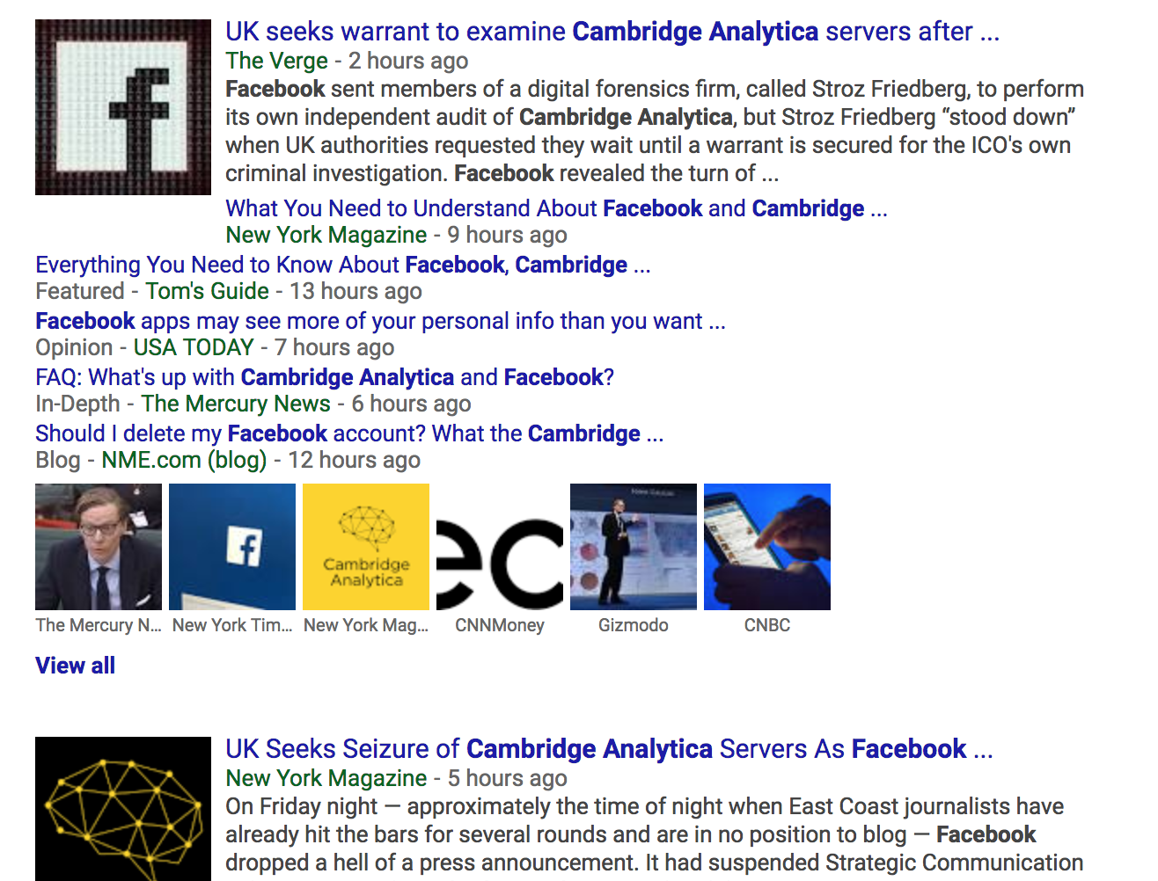
Foreword: Decentralization and Society

Slide 5
Intro: Why Blockchain
Makes Sense for Real Estate
The technology is decentralized, fault-tolerant, and tamper-resistant; offering security and resiliency.
Blockchain is disruptive for land governance, it may promote property rights formalization, registry modernization, and the collection/analysis of data.
Blockchain can generate increased efficiency and lower transaction costs in the global real estate sector.
The technology allows for improved liquidity of property, financial inclusion, and increased foreign investment.

Slide 6
Paper Overview
Foreword: Larger trends in blockchain and decentralization of the internet.
Introduction: Case for blockchain in Real Estate.
Body:
FPR’s seven prerequisites for blockchain introduction into a land registry.
Conceptual framework: Eight levels of integration from the simple to more radical.
Five topics on the future interaction of blockchain and land, from title insurance to regulation.
Six case studies of companies active in the space.

Slide 7
Prerequisites for Blockchain Integration
An identity solution
Digitized records
Multisig Wallets
A private or hybrid blockchain
Accurate data
Connectivity and a tech aware population
A trained professional community
Source: Mike Graglia, Christopher Mellon, and Evan Akin, “Prerequisites for Incorporating Blockchain into a Registry,” FPR Blog (Blog), July 31, 2017, https://www.newamerica.org/international-security/future-property-rights/blog/prerequisites-incorporating-blockchain-registry/.

Slide 8
Prerequisites for Blockchain Integration
An identity solution
Digitized records
Multisig Wallets
A private or hybrid blockchain
Accurate data
Connectivity and a tech aware population
A trained professional community
Source: Mike Graglia, Christopher Mellon, and Evan Akin, “Prerequisites for Incorporating Blockchain into a Registry,” FPR Blog (Blog), July 31, 2017, https://www.newamerica.org/international-security/future-property-rights/blog/prerequisites-incorporating-blockchain-registry/.

Slide 9
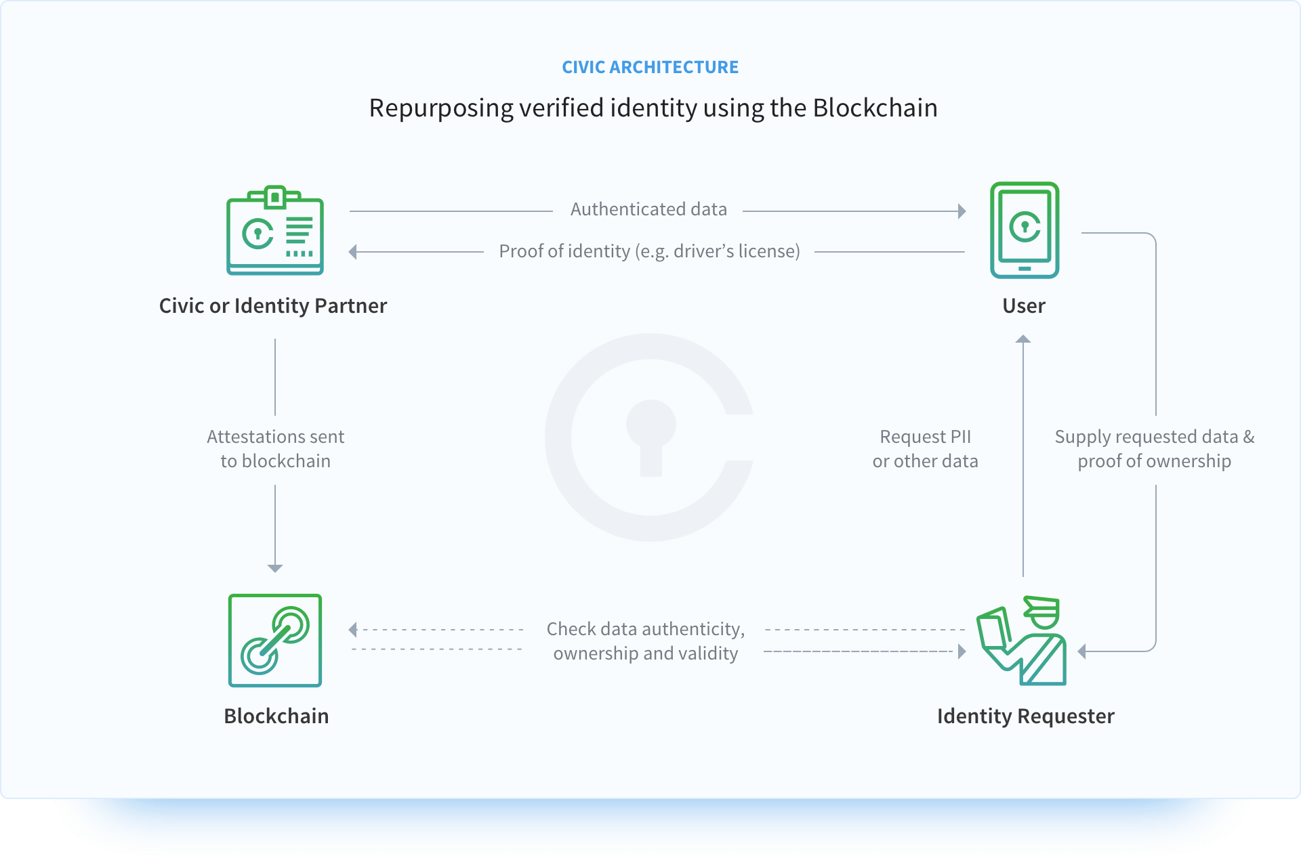
Prerequisites 1: Identity must come first
Example of distributed identity workflow:

Slide 10
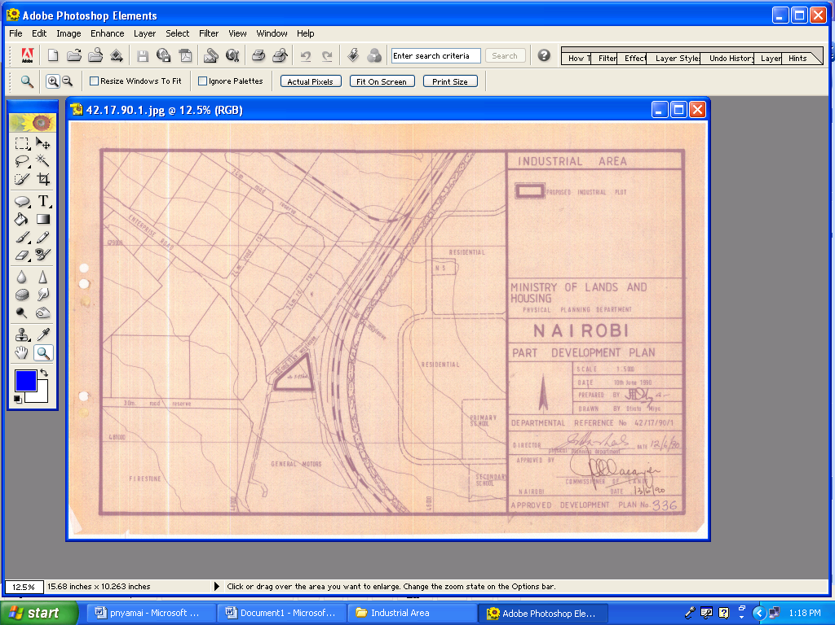
Prerequisites 2: Digitized Records

Slide 11
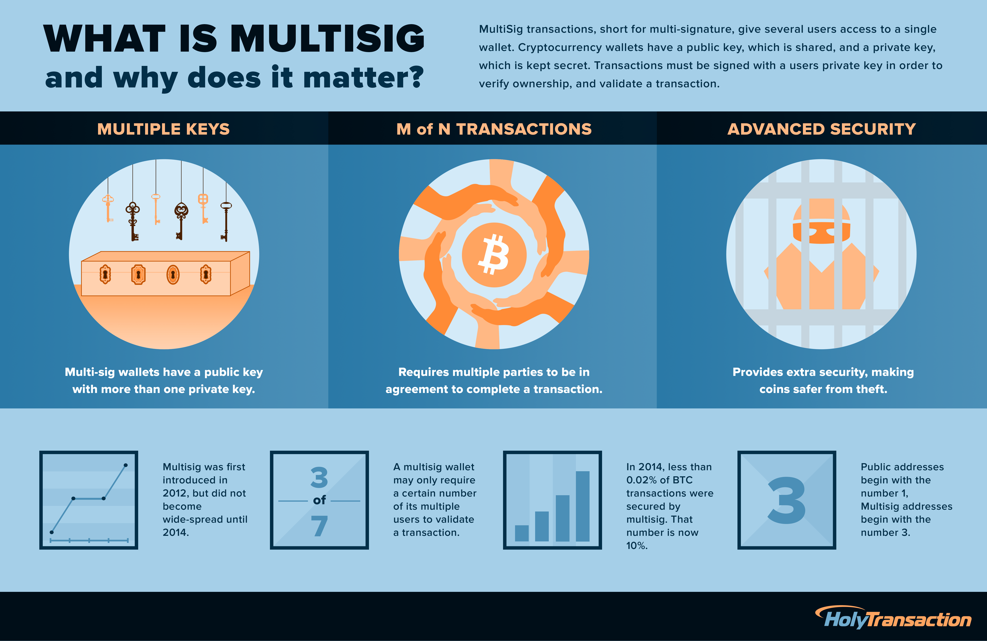
Prerequisites 3: Multisig Wallets

Slide 12
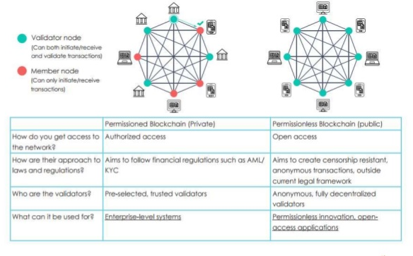
Prerequisites 4: Private Chains are key
Source: www.slideshare.net/Nitishsharma77/blockchain-73134967

Slide 13
Paper Overview
Foreword: Larger trends in blockchain and decentralization of the internet.
Introduction: Case for blockchain in Real Estate.
Body:
FPR’s seven prerequisites for blockchain introduction into a land registry.
Conceptual framework: Eight levels of integration from the simple to more radical.
Five topics on the future interaction of blockchain and land, from title insurance to regulation.
Six case studies of companies active in the space.

Slide 14
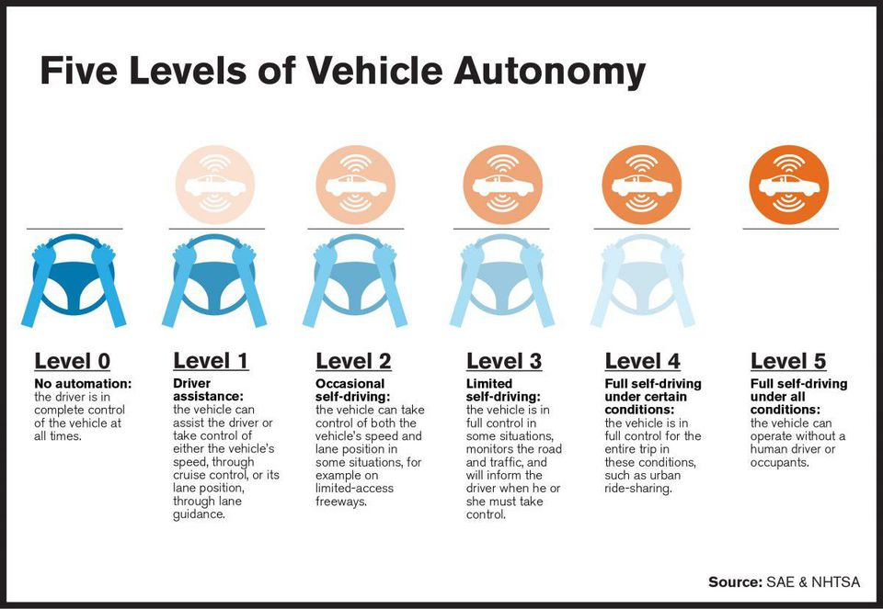
Framework as tool to discuss future tech

Slide 15
Blockchain Registry Integration Framework
Level | Name | Description | Example
0 | No Integration | No use of blockchain | Most of the world
1 | Blockchain Recording | Public blockchain used to record documents related to land transactions | Brazil, Georgia, Dubai
2 | Smart Workflow | Blockchain used to record progress of a transaction | Sweden, Dubai Properties (Landstream)
3 | Smart Escrow | Smart contracts used for escrowing payment | Propy
4 | Blockchain Registry | Central database replaced with a permissioned blockchain | Dubai
5 | Disaggregated Rights | Various rights to a single parcel are disaggregated and managed via blockchain | No known example
6 | Blockchain Fractional Rights | Rights for a given parcel are fragmented and managed via blockchain | Pangea (potentially)
7 | Peer-to-Peer Transactions | Rights are transacted without intermediaries on Level 4 system | No known example
8 | Interoperability | Different blockchain registries merge | No known example

Slide 16
Paper Overview
Foreword: Larger trends in blockchain and decentralization of the internet.
Introduction: Case for blockchain in Real Estate.
Body:
FPR’s seven prerequisites for blockchain introduction into a land registry.
Conceptual framework: Eight levels of integration from the simple to more radical.
Five topics on the future interaction of blockchain and land, from title insurance to regulation.
Six case studies of companies active in the space.

Slide 17
Future of Blockchain for Real Estate
Blockchain can ensure more reliable title insurance records, increasing efficiency and lowering costs.
The simplicity of the Torrens title system may provide the optimal legal framework for a blockchain registry (at higher levels) - since it mirrors the architecture of BC.
Blockchain-based real estate markets can help drive financial inclusion within developing countries.
Blockchain registries and other stores of data can create an unprecedented tool for studying the impact of land governance policies, bringing land into big data.
States will retain the power to regulate and tax land transactions.

Slide 18
Paper Overview
Foreword: Larger trends in blockchain and decentralization of the internet.
Introduction: Case for blockchain in Real Estate.
Body:
FPR’s seven prerequisites for blockchain introduction into a land registry.
Conceptual framework: Eight levels of integration from the simple to more radical.
Five topics on the future interaction of blockchain and land, from title insurance to regulation.
Six case studies of companies active in the space.

Slide 19





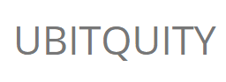
Current Examples of Registries and Blockchain
Company | Product | Geographic Location of Pilot
 | Exonum | Republic of Georgia, Ukraine
 | Postchain | Sweden, India, Australia
 | Landstream, Pangea | Dubai
 | Unnamed SaaS, OpenTitle | Honduras
 | Propy Registry | Ukraine, Vermont
 | Parallel Registry Utilizing Colu Colored Coin Protocol | Brazil

Slide 20
Thank You
NewAmerica.org/FPR
fpr@newamerica.org

